Slide 1
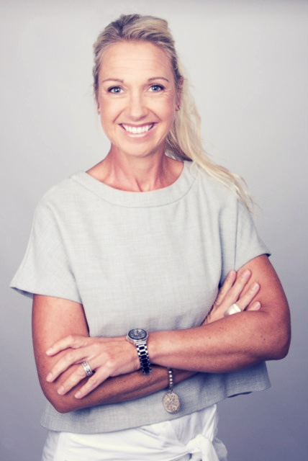
Natalie Waters
Behavioural Profiler, LEADERSHIP and
BUSINESS Coach
www.elevatecoaching.com.au
Email: natalie@elevatecaching.com.au

Slide 2
CODES & PATTERNS of HUMAN BEHAVOUR Understanding People & Human Behaviour Why People do – What they do

Slide 3
PROFILING PEOPLE
Identify some of the Codes and Patterns of Human Behaviour:
What are someone’s stress triggers
What are their motivators
How people make their decisions
‘Why we do – What we do’.

Slide 4
E DISC Behavioural Types
C
15%
D
15%
S
35%
I
35%
Dominant
Compliant
Stabiliser
Influencer

Slide 5
Styles: The D-Style DOMINANT
MOST ASSERTIVE OF THE STYLES Goal and target focused.. Big picture / big vision. Loves getting results and challenges. Definitely likes to lead and be in charge to make things happen. Wants to Win
Decisive
Strong
Willed
Competitive
DESCRIPTIVE TERMS: Big picture thinker, Project leader, idea creator, pioneer, changer, thinks future, adventurous, initiator
UNDER PRESSURE: Angry, lack of concern, direct, arogant
BIGGEST FEAR: Loss of control
Outcome focused
Demanding
Independent
Self-Confident

Slide 6
The DOMINANT Style Communication
D-Style Communication
Often assumes control of the conversation
Says what they think and shows their feelings on their face
Direct and ‘tell’- communication tends to go one way (from them)
Often an impatient listener – may interrupt
Want the short story
Often tells their opinions as facts
Focuses is on outcome / results and big picture
“How can this benefit me?” “For what purpose?”

Slide 7
The DOMINANT Style
Decision Making Approach
Comfortable with difficult decisions
Maintains the BIG picture
Not based on others’ decisions
May forget ‘people aspects’
Wants to make fast, independent decisions
Doesn’t need a lot of information
Decision = Fast, Criteria based (Trust that you can deliver)
Decision Strategy = Automatic with Criteria

Slide 8
Styles: The I Style INFLUENCER
MOST SOCIAL OF THE STYLES Likes connecting and interacting with others so they gain energy from them. Relationship driven. Enjoys being the center of attention and loves teamwork. Sees the positive side of life and others, therefore often comes across as happy and fun
Want to be Liked
Sociable
Open
Energetic
DESCRIPTIVE TERMS: Performer, optimist, ideas generator, outgoing
UNDER PRESSURE: Disorganised, lack of focus, short attention span
BIGGEST FEAR: Social rejection
Talkative
Enthusiastic
Influential & Persuasive
Inspiring

Slide 9
The INFLUENCER Style Communication
I-Style Communication:
Needs to contribute so interrupts to participate
At times a bit indiscreet
Strays off topic – Hard to focus
Excellent at giving good constructive feedback
Chatty and inspiring - encouraging
Uncomfortable with silences
Can get enthusiastic when agreeing - passionate
May not take in details of what’s being said
Prefers pleasant or fun issues - avoiding conflict and detail

Slide 10
The INFLUENCER Style
Decision Making Approach
Doesn’t need a lot of supporting information
Fun / connection with others element
Not too details – hard
Must have variety
Emotions / feelings based
Decision = Fast, Non Criteria based
Decision Strategy = Automatic with No criteria

Slide 11
Styles: The S Style STABILISER
MOST OUTWARDLY CALM OF THE STYLES Likes a steady/safe environment so tends to not like change or surprises. Fairness and justice are important. Often agreeable on the surface.
A very reliable person that will always understand and often take on other’s responsibilities.
Wants to be Comfortable
Calm
Thoughtful & caring
Good Listener
DESCRIPTIVE TERMS: Compassionate, modest, sensitive, family oriented, happy to follow, helpful, balancing force, stable, systematic, thoughtful
UNDER PRESSURE: People pleaser, rescuer, indecisive
BIGGEST FEAR: Loss of stability
Loyal
Patient
Reserved
Trustworthy

Slide 12
The STABLISER Style Communication
S-Style Communication
Communication in one direction – they listen
Answers when asked and doesn’t interject
Prefers to talk one-to-one (not large groups)
Actively pays attention – good instructor
Patient and empathetic listener – engages fully
Can resist if message suggests change
Sees a variety of viewpoints

Slide 13
The STABLISER Style
Decision Making Approach
Are very cautious / conservative
Slower as they like to recheck
You need to give all relevant information and time
You need to warn about upcoming risks and issues
They prefer support when making decisions
Thinks about how it has been solved in the past
Decision = Poor, Fence sitter
Decision Strategy = Period of Time Convincer

Slide 14
Styles: The C Style COMPLIANT
MOST CAUTIOUS OF THE STYLES Likes things to be correct and in logical order. Avoids mistakes, strives for perfection. Attention to detail.
Wants to be Right
Follows Rules
Analytical & Logical
Formal
DESCRIPTIVE TERMS: Quality controller, criticiser, specialist, detailed, perfectionist
UNDER PRESSURE: Overly critical, procrastinate – must be right
BIGGEST FEAR: Criticism of work (Respect of doing good job and being right)
Precise
Careful
Disciplined
Expert

Slide 15
The COMPLIANT Style Communication
C-Style Communication
Often prefers written communication
Master of details but often loses big picture
Doesn’t relate to anything with emotions – non physical
Likes discussion to have facts and proof – refers to rules
Asks a lot of questions to determine genuine facts
Doesn’t provide much feedback

Slide 16
The COMPLIANT Style
Decision Making Approach
Concentrates on facts and details
Needs a lot of supporting information
Needs space and time
May forget the BIG Picture
Decision= Slow, Wants to see Proof
Decision Strategy = Number of times x 3 Convincer

Slide 17
WHO ARE YOU?
Precise, attention to detail, follow rules
Analytical, logical, expert SME
Doesn’t relate to emotions
Gets stuck in details, loses big picture
Under Pressure: overly critical, procrastinate
Comm Style: Prefers written, asks Qs
Decision Making Strategy: 3 x times convincer
Big picture, future thinker, visionary
Goal/outcome focused, competitive
Demanding, results
Under Pressure: Direct, arrogant
Comm Style: Takes control, impatient interrupts, wants short story
Decision Making Strategy: Auto with criteria (Criteria = trust that you can deliver)
C
D
S
I
Calm, patient, reserved
Trustworthy & reliable
Certainty, security, resists change
Under Pressure: People pleaser, rescuer
Comm Style: 1:1, Doesn’t express themselves or provide feedback
Decision Making Strategy: Period of time convincer
Sociable, loves connection, relationships
Loves center of attention, talkative, open
Influential, persuasive
Under Pressure: Disorganised, lack of focus, frantic
Comm Style: Contributes, strays off topic, doesn't take in details, gives the long story
Decision Making Strategy: Auto with criteria
Notes:
17
Note the colours D = red (fiery), I = yellow (friendly and sunny), S = green (nurturing and concerned about people their environment) and C = blue (more clinical).

Slide 18
PROFILING OTHERS 1. OBSERVE and IDENTIFY - who you are dealing with
Task Focused
C
15%
D
15%
S
35%
I
35%
Dominant
Compliant
Introverted
Extroverted
Stabiliser
Influencer
People Focused

Slide 19
PROFILING OTHERS How to Identify who you are dealing with
STEP 1. OBSERVE / PROFILE
STEP 2. IDENTIFY / ASSESS
STEP 3. ADAPT

Slide 20
Step 1: OBSERVE AND ASSESS
C
I
S
D
Introverted:
Likes being by oneself to recharge.
They like a bit of space -
Might read a book / go for a walk.
Extroverted:
Likes being around others and interacting to gain energy.
Being social is not taxing on them.
INTROVERTED
RESERVED
ACTIVE
EXTROVERTED
Talks about the past and the present – how things are now
Speaks with a fairly calm and quiet voice
Tends to prefer to analyse things properly
Spend time making sure every action is the correct action.
Talks about the future and how things could be
Demonstrate body language that is animated and assertive
Maintain strong eye contact
Notes:
20
This slide is VERY important take time to ensure they understand
HORIZONTAL AXIS
Extroverted: like being around others and interacting to gain energy. Being social is not taxing on them.
e.g. if you have a bad day – meet up with friends for coffee or go to the pub
Active paced: in decision making, speed of speech, physical actions
Intuitive: feel their way through an issue, even if they haven’t experience it before. Person who looks for challenge, freedom, achievement, renewal and creativity. Starting new projects and explaining new ideas is fascinating for them. They rely on a ‘sixth sense’ (insight). They are interested in the ‘outer world’.
Introverted: like being by oneself to recharge. They like a bit of space.
e.g. might read a book or go for a walk.
Reserved paced: in decision making, speed of speech, physical actions
Sensing: tend to analyse using their 5 senses (touch, smell, taste, sight & hearing). Especially past experiences that are similar. Sensing refers to a person who prefers to analyse things properly and spend time making sure every action is the correct action. They are interested in the ‘world of ideas’.

Slide 21
Task Oriented
Focuses more on the task and getting things done
Doesn’t show a lot of emotion
Next…..
C
D
TASK ORIENTED THINKING
PEOPLE ORIENTED
FEELING
I
People Oriented:
Talks and asks about people
Shows emotion easily
S
Notes:
21
This slide is VERY important take time to ensure they understand
VERTICAL AXIS
Task or thinking oriented: value is seen in facts, goals, rules, achievements and personal freedom. Wants to work for personal goals and to do so independently. Decisions are often based on facts.
People or feeling oriented: need to know others’ opinions before making decisions and consider how they might effect others. Exchanging opinions and feelings is important. Opinions are often emotion-based.
STOP HERE AND REVIEW AGAIN TO ENSURE THEY UNDERSTAND, ASK QUESTIONS ABOUT IT
Each part of the Quadrant is given a name and a colour so we can identify the attributes of each part of the quadrant as a group.
‘D’ for Dominance (colour RED)
‘I’ for Influence (colour Yellow)
‘S’ for Steadiness (colour Green)
‘C’ for Compliance(colour Blue)
Other DISC-based assessments use different identifying names.

Slide 22
STEP 2. IDENTIFY
Task Focused
C
15%
D
15%
S
35%
I
35%
Dominant
Compliant
Introverted
Extroverted
Stabiliser
Influencer
People Focused

Slide 23
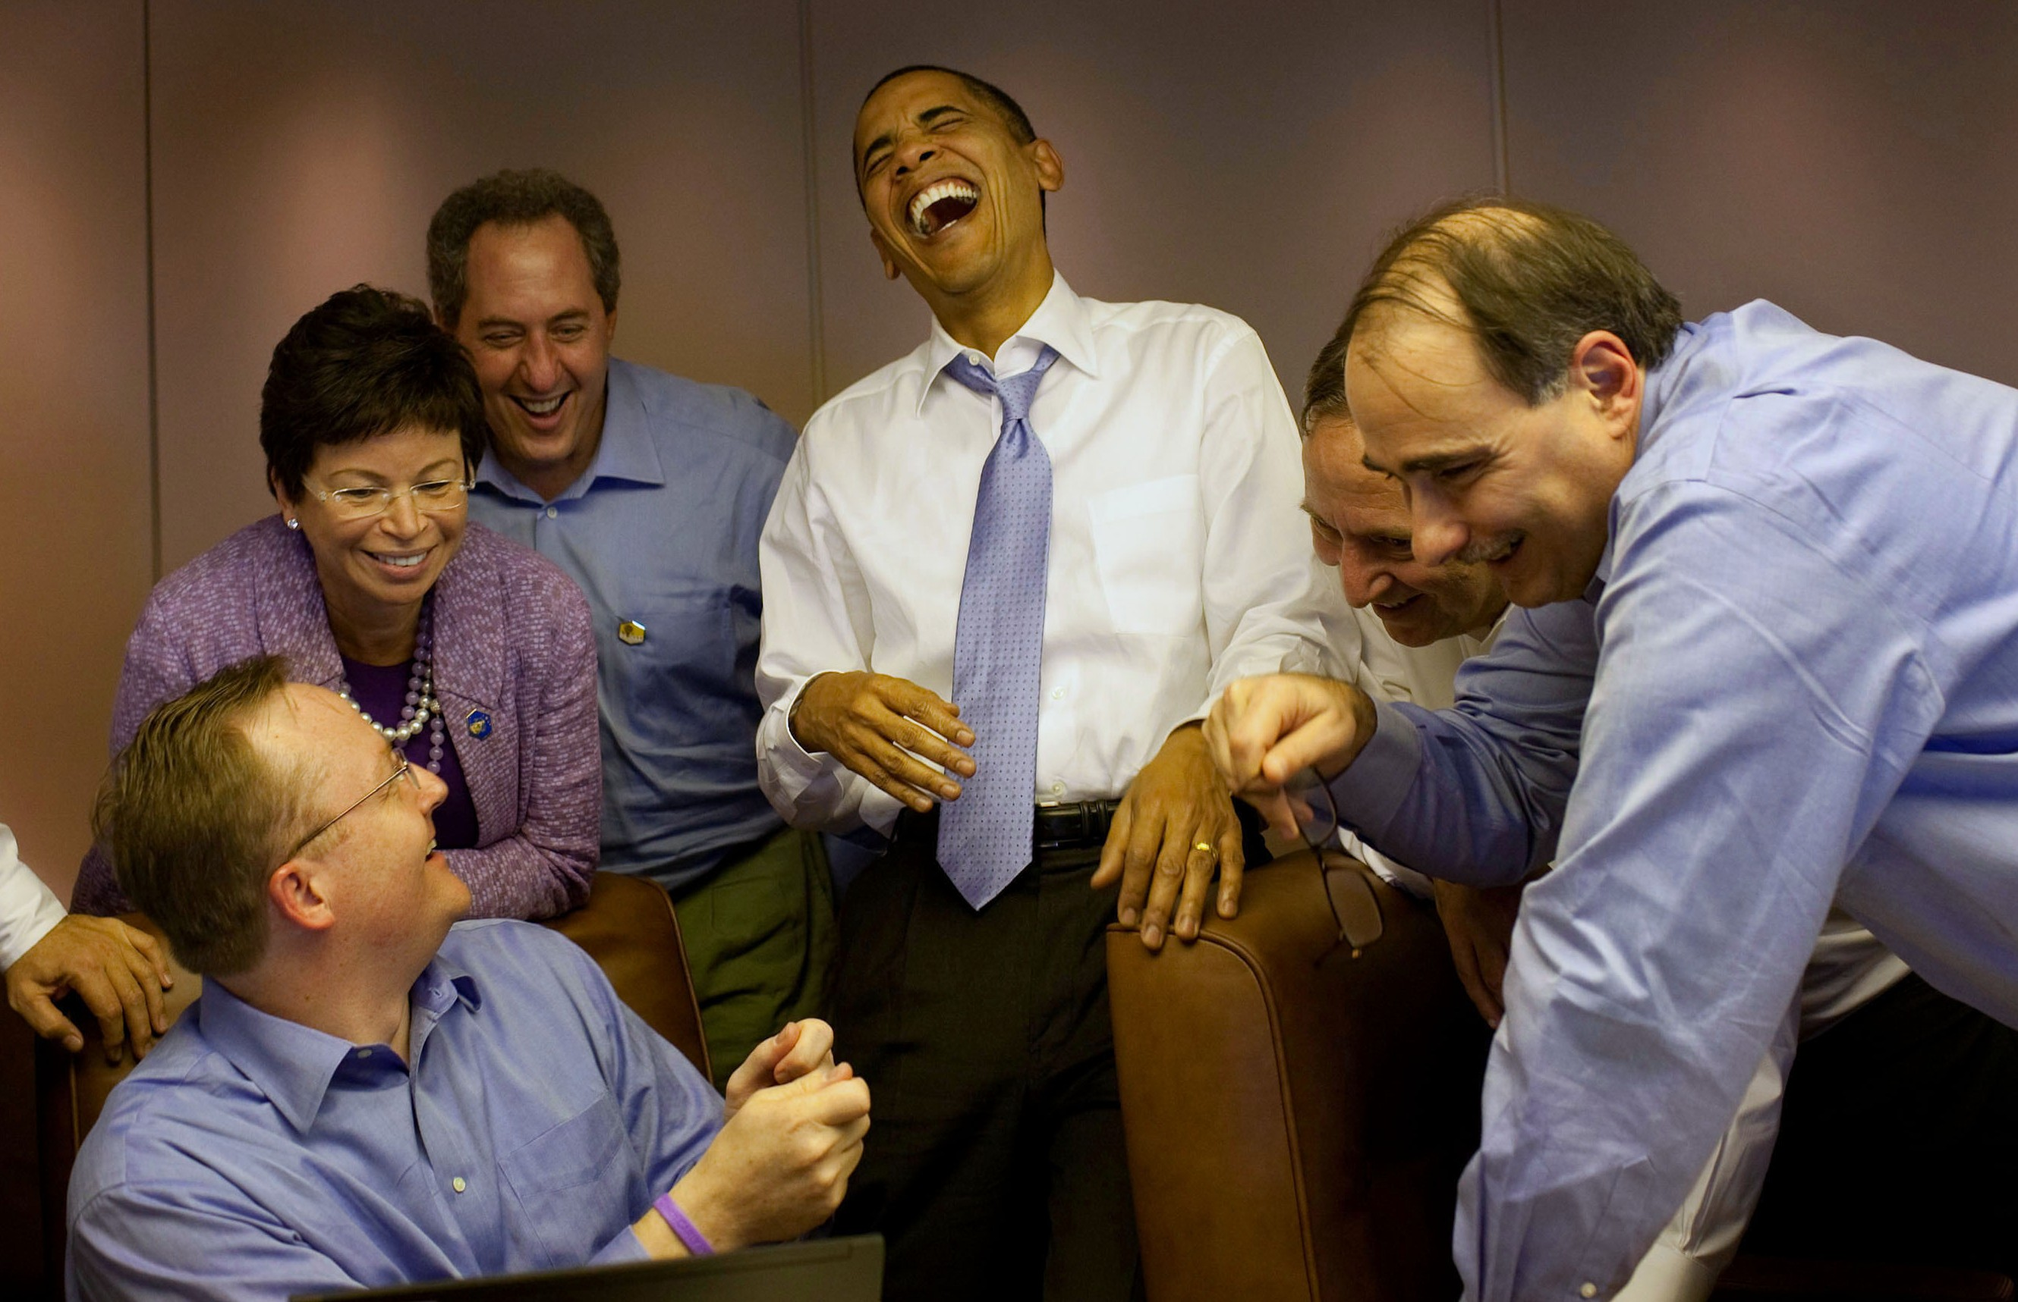
STEP 3. ADAPT
Make some changes towards:
The way you communicate with them
The level of detail you go into
The questions that you ask
The way you prepare for a meeting
The way you pitch and sell
The way you follow up
Your expectations on how they are going
to make a decision

Slide 24
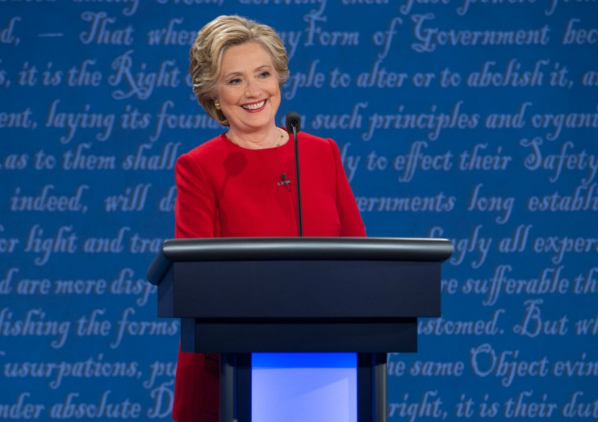
WHEN DEALING WITH A – D STYLE PERSON
MUST DOS
Show that you are confident, but respect them
Be direct, focus on the subject/topic
Give them outcomes and how THEY can benefit
Know your subject/topic and be prepared
Be very systematic and concise in what you say
Summarise the main points you have discussed
Boost their ego and put yours aside
DON’TS
Indecisive
Provide too much information / go into too much detail
Talk too much about you
Get side-tracked or lose focus on the subject/topic
Take issues personally
D

Slide 25
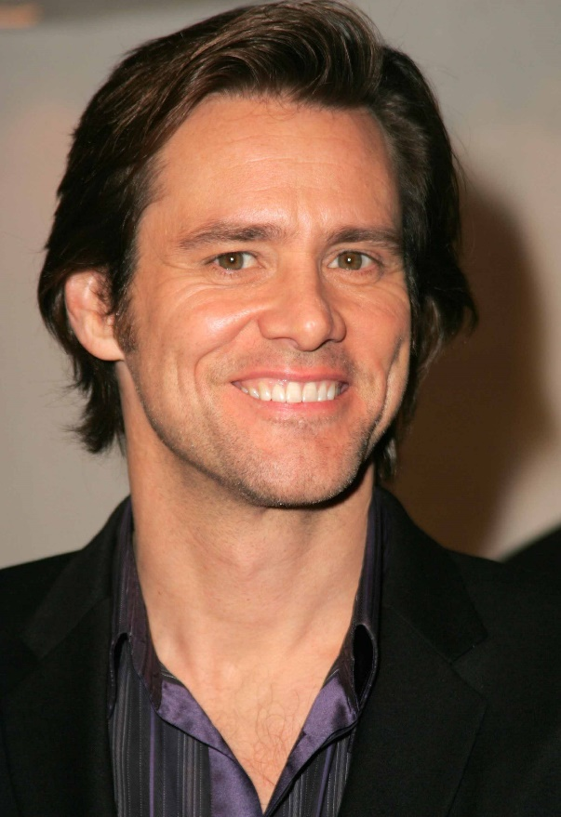
WHEN DEALING WITH A – I STYLE PERSON
I
MUST DOS
Maintain a positive atmosphere
Talk briefly – offering them more time to talk
Be prepared to do a lot of listening
Be as enthusiastic as they are
Focus on the people and fun aspect of the subject/topic
Focus on the big picture
DONTS
Don’t interrupt if they get excited
Talk too much about structure
Appear to be too serious – put down their enthusiasm
Bring up negative issues
Focus on too many details
Set too many restrictions

Slide 26
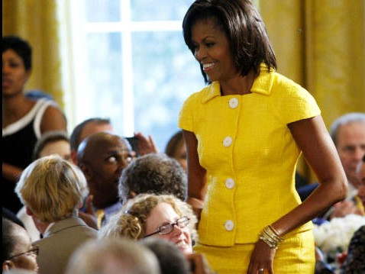
WHEN DEALING WITH A – S STYLE PERSON
MUST DOS
Create trust
Ask specific questions to find out true needs – listen carefully
Remember the detail of what they have told you
Provide all the facts they need
Explain to them logically how it is going to work
Ask if they have any more questions – Follow up
Provide support and check in
Call them from time to time - to just see how they are doing
DON’T’S
Expect a decision straight away – don’t put pressure
Make unexpected changes – forget what was agreed
Forget their name or detail they have told you
Be unreliable
S

Slide 27
WHEN DEALING WITH A - CSTYLE PERSON
MUST DOS
Set aside enough time
Maintain distance they want to keep
Be thorough - include more facts, details, research than they are expecting
Listen carefully – when they talk, their questions will be relevant
If you require anything from them – state well in advance
Cover one topic at a time – don’t skip anything. Methodical and logical
Provide all material in writing focus on just the product / service – not personal
DON’TS
Come across too friendly/emotional
Spend too much time on small talk
Loose patience or move too fast – they focus on the detail and will analyse everything
Get caught in providing incorrect/inaccurate information
Forget to cover the available support and guarantees
Expect a decision straight away – no pressure
C

Slide 28
Natalie Waters
Work with me:
Keynotes
Business coaching & mentoring
Leadership coaching
Teams coaching
Profiling
www.elevatecoaching.com.au
Email: natalie@elevatecaching.com.au

